Slide 1



Developing Customer Empathy
Chris Witeck
Principal Technology Strategist- Citrix Labs
November 2015

Slide 2
Design Thinking and Empathy
Why develop empathy?
Observation and Empathy
Case Study Examples
Positives, Negatives, Lessons learned
Summary
Agenda

Slide 3
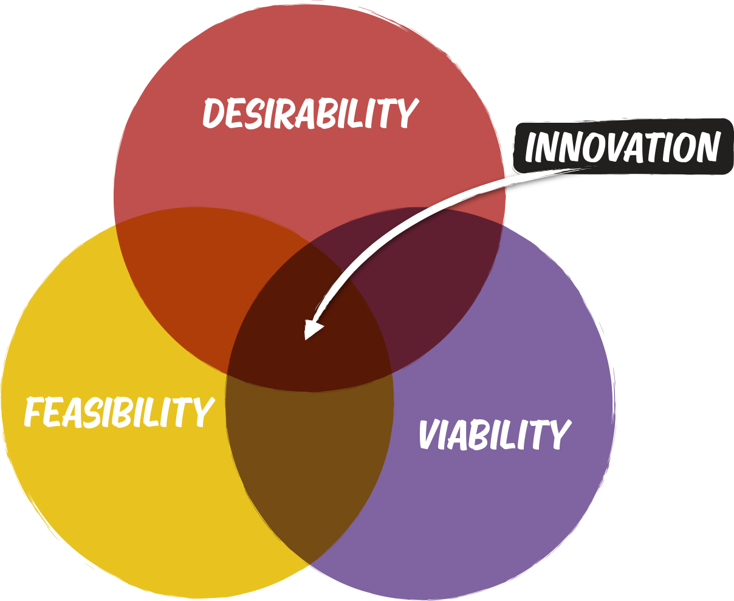
The Goal: Innovation
Desirability: Make something someone wants
Viability: Make something that can be part of a sustainable business
Feasibility: Make something you can actually make
Notes:
Desirability: Make something someone wants.
Viability: Make something that can be part of a sustainable business
Feasibility: (Technological & Organizational) Make something that you can actually make
Design thinking – the folks who popularized DT came up with these ideas as well as mindsets that are powerful across all 3, and a toolkit that’s especially powerful for desirability.
Lean innovation which is particularly strong on evidence-driven innovation
We’ll use a tool called the business model canvas for viability
& we’ll do a lot of prototyping, low-fi to medium, very rapid prototyping.
What order would you use?
We’ll spend roughly a day or a day and half on each of these three ideas.
Today is about desirability – how do you identify a target customer, with a real need, and how do you identify something that addresses that need? How do you convince yourself you have it?
How we’ll work:
80% action
Urgency -- Time-boxed – you will feel like you don’t have enough time.
Empathy – Human focused innovation – leverage your understanding of real
Evidence -- When in doubt, try something & learn: you’ll be making your ideas visible and testing them throughout the 3 days, in all of these areas.

Slide 4
Design Thinking is Customer Led Innovation
Design Thinking is Human-Centered Innovation
Notes:
Remember what is your customer made up of? You don’t want to genericize the customer as an entity

Slide 5
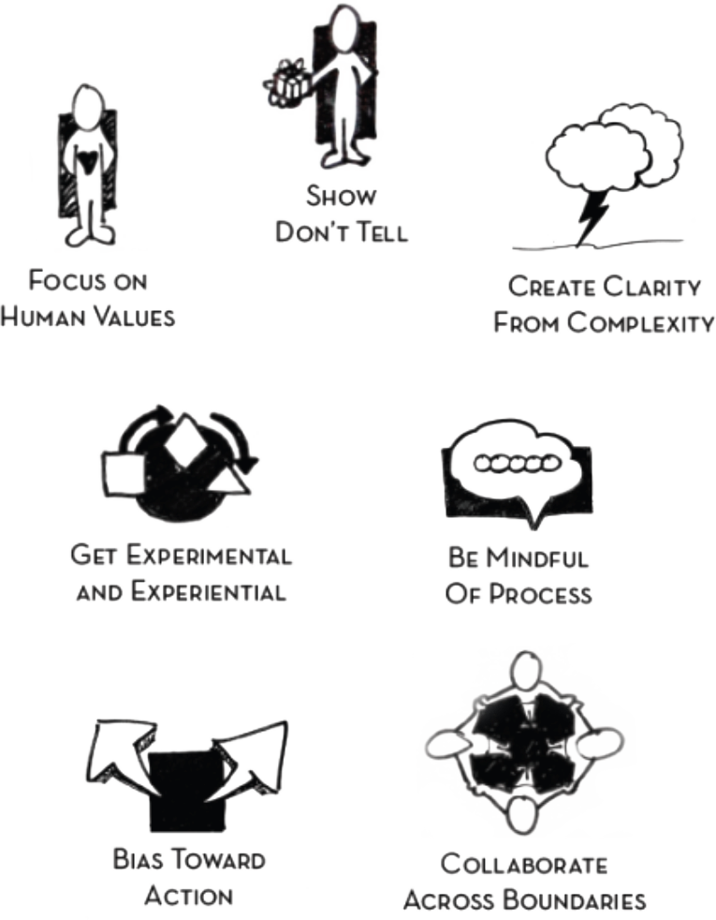
Design Thinking Mindsets
Notes:
Design Thinking Mindsets
http://dschool.stanford.edu

Slide 6

Design Thinking
EMPATHY
PUT YOURSELF IN THE USER’S SHOES
PROTOTYPE
MAKE IT REAL
IDEATE
ENVISION THE FUTURE

Slide 7
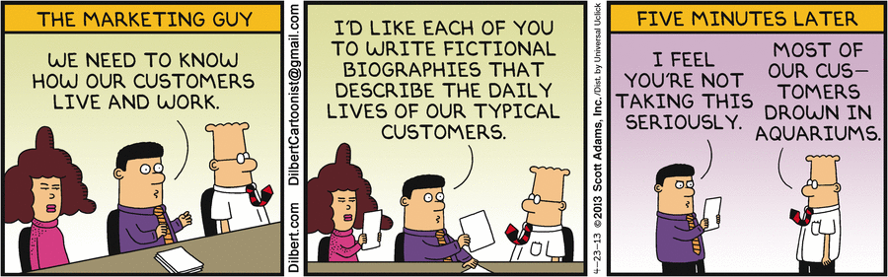
Why Develop Empathy?

Slide 8
“A lot of times, people don’t know what they want until you show it to them”
Steve Jobs
“If I had asked people what they wanted, they would have said faster horses”
Henry Ford*
Why Develop Empathy?
Don’t innovators just innovate and not listen to customers?
“Get closer than ever to your customers. So close, in fact, that you tell them what they need before they realize it themselves”
Steve Jobs
“Most people do not listen with the intent to understand; they listen with the intent to reply”
Stephen R Covey

Slide 9
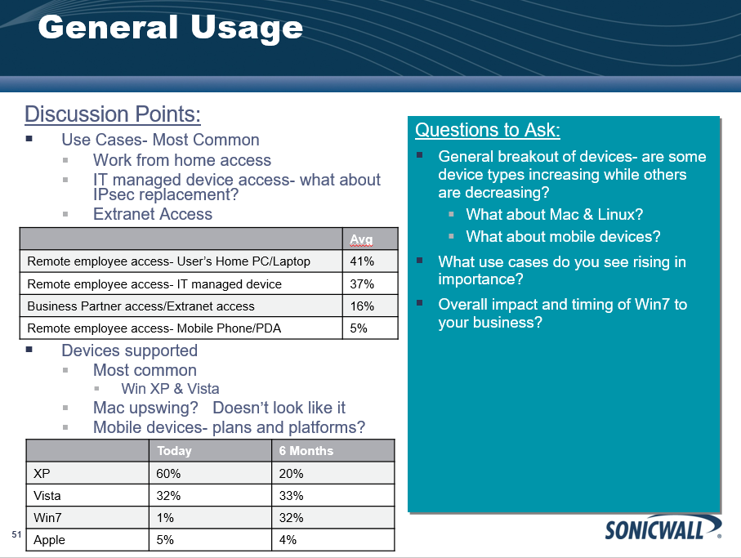
My Empathy Approach Circa 2009
Problems with this approach?
Notes:
I led with too much data, I was not observing, I was leading with a need
Is room for a tops down/bottoms up approach, sometimes we focus too much on the bottoms up

Slide 10
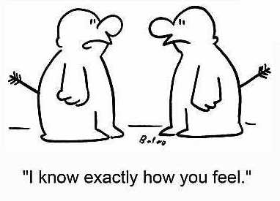
Empathy Put yourself in the user’s shoes
Focus in on one person to gain a human understanding
Desirability is one person at a time
You will need data later to convince yourself there is a market
Notes:
1st step is gaining empathy for the user you’re designing/coming up with a solution for

Slide 11

Look below the surface
Look with fresh eyes
Have a sense of “Vuja De!”
“I have seen this a million times but it feels like the FIRST time I am seeing it”
How do we develop empathy?
Notes:
1st step is gaining empathy for the user you’re designing/coming up with a solution for

Slide 12
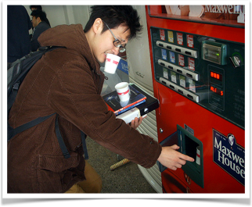
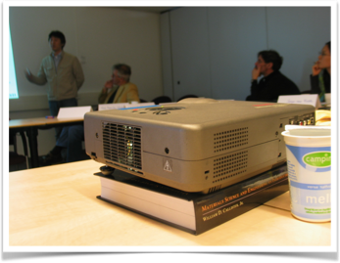

Observation is the Key to Developing Empathy
Insights from the (super)ordinary
Notes:
Look for user hacks: buying and carrying multiple cups of coffee from a vending machine, prompting a projector up higher to match the screen, tying a teabag around the cup handle to prevent from falling out/floating while sipping tea

Slide 13
Observing in Practice:
Learn
Prototype
Beta
Assess
Assess
Start
Project Duration
Finish
How do you know you hit the mark?

Slide 14
Observing in Practice: Observe Throughout the Entire Project
Learn
Observe
Assess & Observe
Prototype
Beta
Start
Project Duration
Finish

Slide 15
Engage your interviewee
The more emotional breadth you capture the better
The most important thing in communication is to hear what is not said
Interviewing Tips
Notes:
Get at emotions

Slide 16
Seek and encourage stories (Tell me about a time when…)
Ask truly open-ended questions
Don’t be afraid of silence
Stay on the same path of a question (Ask follow-up questions)
Follow up with “WHY?”
Interviewing Tips
Notes:
Get at emotions

Slide 17
Who do you Interview?
The Stakeholder Chain
SOMEONE NEEDS HELP:
NOW THERE’S A WAY:
Choose a key stakeholder – solve for them
Everyone upstream has to benefit
Everyone downstream has to benefit (or at least not lose)
Notes:
Who do you most want to talk to and observe as you go farther? -- that’s your key stakeholder, talk to everyone but especially that person.
Example, done as a group: (Doug Dietz’ story)
Someone needs help: Children are terrified by MRIs
Now there’s a way: Child-friendly experience
Who are the stakeholders? (map with stickies – place yourself, the child, and then everyone who you have to influence in order to get the value to that child.)
Who is the key? Who has the most at stake? This persona will give you the most insight
What is the benefit of solving that person’s problem? (at least everyone upstream from that person)

Slide 18
Who do you Interview?
Example: Building a Telemedicine Solution
SOMEONE NEEDS HELP:
NOW THERE’S A WAY:
Key Stakeholders
Telemedicine Solution
Your Developers, Marketing, Sales
Doctor
Nurses
Specialist
Insurance Providers
Medical Clinic IT
Patient
Initial interviews- focus on user experience, key stakeholders
Prototype interviews- focus on user experience and workflow
Business model interviews- focus on influencers and buyers
Notes:
Who do you most want to talk to and observe as you go farther? -- that’s your key stakeholder, talk to everyone but especially that person.
Example, done as a group: (Doug Dietz’ story)
Someone needs help: Children are terrified by MRIs
Now there’s a way: Child-friendly experience
Who are the stakeholders? (map with stickies – place yourself, the child, and then everyone who you have to influence in order to get the value to that child.)
Who is the key? Who has the most at stake? This persona will give you the most insight
What is the benefit of solving that person’s problem? (at least everyone upstream from that person)

Slide 19
________ needs a way to ________
(describe user with adjectives) (verb)
because _____________________
(insight, problem statement)
Needs Statement
Translating empathy insights into something actionable
Notes:
A need statement is like a personal ad for your user in the newspaper and it has to be juicy. Can it generate lots of ideas, not just the ladder?
ALT:
Someone Needs Help, Now There’s a Way
We met _____________. We were amazed to discover that ________________. We think it would be game changing if _________________.

Slide 20
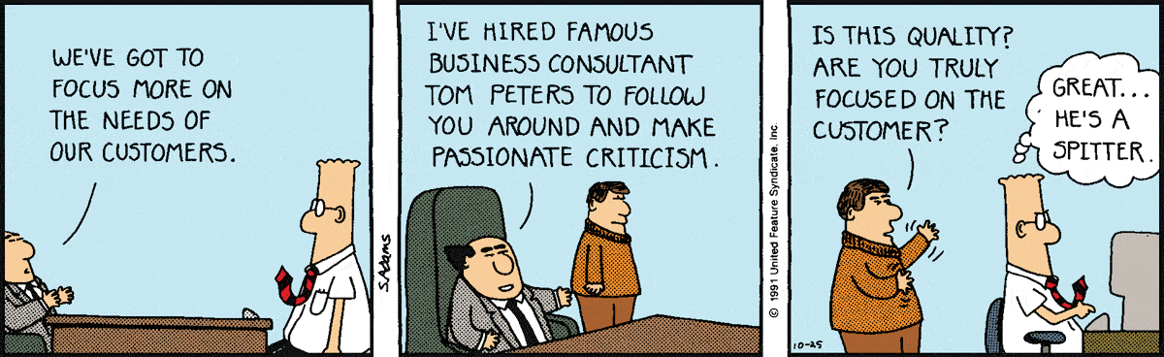
Get outside your comfort zone
Participate in interviews
Ask to see the results
Ask questions
Expect needs statements, problem statements
Don’t be afraid to share/show partially completed & not pretty work
After each milestone, ask if you are meeting the need
Involving the Technical Team: How?
Closing the Gap
Notes:
Get at emotions

Slide 21

Empathy Mapping in Practice
Case Study: Citrix PatientConsult

Slide 22
Initial Assumptions
What we wanted to test in our initial interviews
Smart treatment workspace that enables a better patient-doctor relationship
….. (through continuous, just-in time communication in different physical environments)
Our Assumptions:
Our Customer
We believe that our customer is a private practice clinician treating at home patients and non-urgent needs
Their Needs
Want to see more patients to increase productivity
Easier ways to collaborate across distance
Better relationships with their patients

Slide 23
Initial Interviews
Get to know who we are talking to
Interview Script: User Profiling
Can you tell me a little about what you are responsible for?
Walk me through your typical (a good/bad, yesterday, productive/not) day….
What are your top priorities right now?
For each priority/ job ask:
What is the goal
What are the biggest challenges you have had
Can you tell me a little bit about the last time you had this problem?
What does a successful doctor-patient relationship look like to you?
Initial questions focused on goals & challenges
We did not ask them what they needed
We wanted to observe what excited them, what frustrated them
23
Notes:
Here’s the empathy part of the interview.
One thing that’s really important – Renee called this out last time: Notice you ask about the person and their goals & challenges, not their needs.
What happens if you ask someone what they need?
If this is an empathy interview, you stop here. You don’t have any assumptions to test yet. The interviews you’ll do in the next couple of weeks will likely have this character.

Slide 24
Initial Interviews- Test #1
The assumptions/solution test changed as we ramped fidelity of our idea
Interview Script: Solution Test
Smart treatment workspace that enables a better patient-doctor relationship (through continuous, just-in time communication in different physical environments).
Be silent, wait for customer’s first reaction
Ask for feedback, is this clear to them what this means?
Do they like it? why/ why not.
How would they find out about a solution like this?
Who would be involved in the decision?
Any one else doing this, why, why not?
The solution test started with a simple statement
This was used to generate an open ended discussion
24

Slide 25
Initial Interviews- Test #2
The assumptions/solution test changed as we ramped fidelity of our idea
Interview Script: Solution Test
SmartSpaces helps private practice clinician treating non-urgent needs see more patients to increase productivity.
2. SmartSpaces provides private practice clinician treating non-urgent needs an easier way to provide care for patients across distance and to create better relationships with remote patients.
Be silent, wait for customer’s first reaction
Ask for feedback
How/if this resonates, where does it fit with their overall problems / needs
What if anything do you currently do to solve this need
As we learned, we added more detail
….to focus our observations
….to help us generate ideas for our prototype
25
Notes:
Here’s the empathy part of the interview.
One thing that’s really important – Renee called this out last time: Notice you ask about the person and their goals & challenges, not their needs.
What happens if you ask someone what they need?
If this is an empathy interview, you stop here. You don’t have any assumptions to test yet. The interviews you’ll do in the next couple of weeks will likely have this character.

Slide 26
Initial Interviews- Test #3
The assumptions/solution test changed as we ramped fidelity of our idea
Interview Script: Solution Drill Down Test
Secure communication image sharing platform
Online accessible platform: smart appointments, wearables, virtual appointments, patient background - all in a single platform. A new way to see your doc/patient
Create a outpatient care plan app (what patient needs to do, check off when done)
Pop-up for non-urgent care: create a pop-up space similar to KP/Target one for non-urgent care with a secure tablet solution for pic-taking, labs/info/results transmission, doc consultation, best practices, teleprompters
We used learnings to find specific ideas to test, to observe reactions to
26
Notes:
Here’s the empathy part of the interview.
One thing that’s really important – Renee called this out last time: Notice you ask about the person and their goals & challenges, not their needs.
What happens if you ask someone what they need?
If this is an empathy interview, you stop here. You don’t have any assumptions to test yet. The interviews you’ll do in the next couple of weeks will likely have this character.

Slide 27
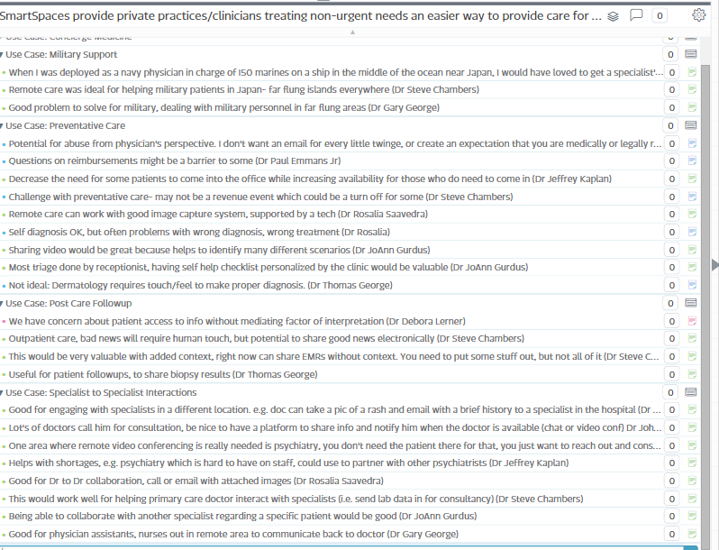
Initial Evidence
Interview synthesis:
Organized reactions to initial statement into use cases
Green= good reaction, pink= neutral reaction, blue=negative reaction

Slide 28
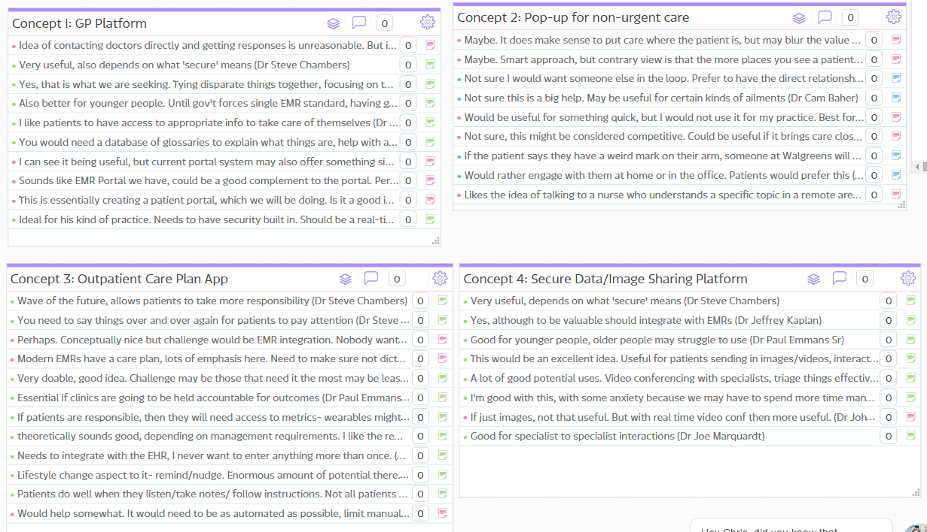
Initial Evidence
Interview synthesis:
Captured reactions to solution test
Measured emotional reactions
Captured problem statements
Green= good reaction, pink= neutral reaction, blue=negative reaction
Notes:
Interesting observations
EMR is the pivotal element in healthcare tech right now
Practitioners want to provide better care but concerns over patients interrupting all the time
Patients cant be assumed to know how to interpret data sent to them
Tech needs to fit into workflow
Need to do some patient validation
There is something in specialist to specialist/doctor to specialist collaboration

Slide 29
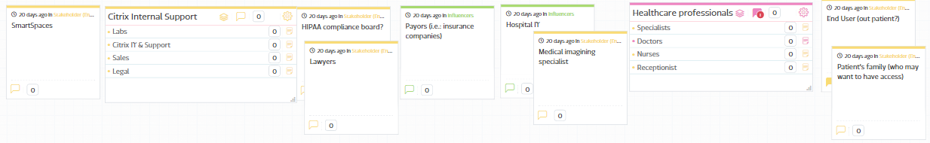
Stakeholder Chain
Based on initial interviews, we developed our stakeholder chain
We focused interviews on the key stakeholder, but tried to pull in other stakeholders as well
Key Stakeholder : Healthcare Professional

Slide 30
Revised Assumptions
We learned we had to pivot
Smart treatment workspace that enables a better doctor-to-specialist collaboration.

Slide 31
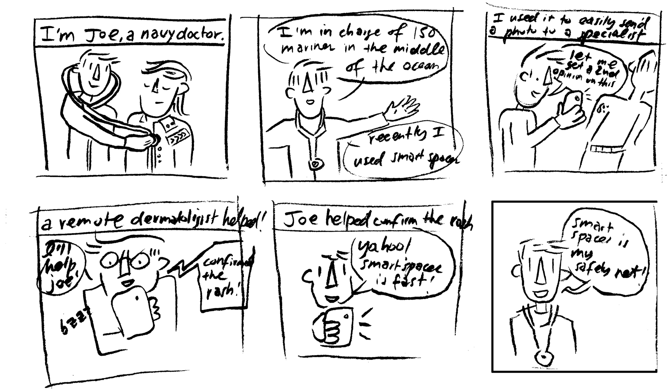
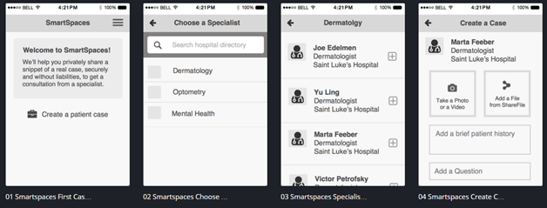
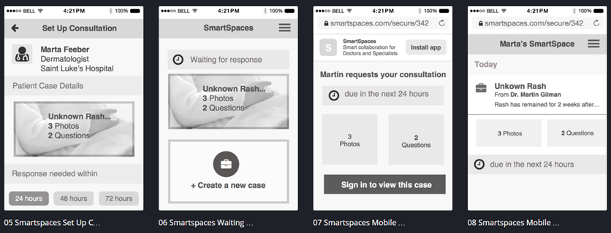
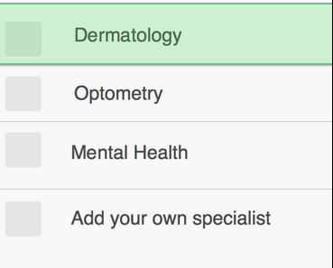
Revised Interviews
Post pivot we continued to enhance the fidelity of our idea
Testing rough storyboards
Testing rough workflows
Notes:
Here’s the empathy part of the interview.
One thing that’s really important – Renee called this out last time: Notice you ask about the person and their goals & challenges, not their needs.
What happens if you ask someone what they need?
If this is an empathy interview, you stop here. You don’t have any assumptions to test yet. The interviews you’ll do in the next couple of weeks will likely have this character.

Slide 32
Empathy Mapping Journey
We Heard: This would be ideal for talking to specialists
We Heard: This would be ideal for talking to specialists
Emotional Shift: This would be fantastic!
Initial Assumptions
Round #1
Solution Ideas
Round #2
Value Prop Test
Round #3
Patients are comfortable interacting with their doctor remotely
Comprehensive online accessible platform
Patients: Yes
Doctors: Perhaps
Yes
Doctor to Specialist
Collaboration
Yes!!
Patients are looking for better ways to interact with their doctors
Image sharing platform
Doctors are looking for better ways to remotely interact with their patients
Preventative care: No
Post visit care: Maybe
Outpatient care plan app
Perhaps
Clinicians want to see more patients to increase productivity
Pop-up physical presence
No!
No!

Slide 33

Lessons Learned
Handoff to development broke the empathy chain
Positives:
Established an emotional connection to a need
Successful executive pitch
Development funding
We built a prototype available to use today
Negatives:
Handoff to development broke the empathy mapping chain
Development felt very waterfall
Prototype missed the mark in some areas
Summary:
Need to keep learning, testing, building empathy throughout the entire project
Need better ways to ‘close that gap’
Notes:
Here’s the empathy part of the interview.
One thing that’s really important – Renee called this out last time: Notice you ask about the person and their goals & challenges, not their needs.
What happens if you ask someone what they need?
If this is an empathy interview, you stop here. You don’t have any assumptions to test yet. The interviews you’ll do in the next couple of weeks will likely have this character.

Slide 34

Empathy Mapping in Practice
Case Study: Citrix Project Minerva
The Internet of Things Enabled Classroom

Slide 35

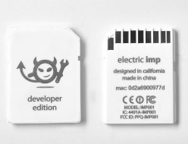
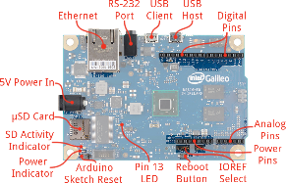
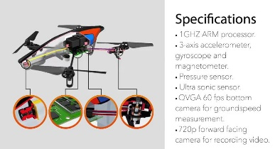
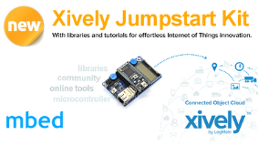
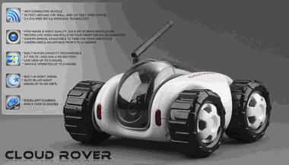
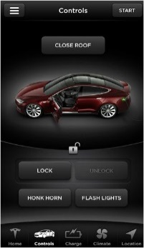
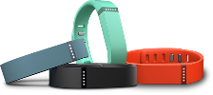
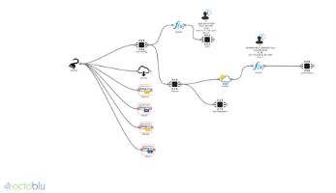
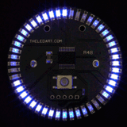
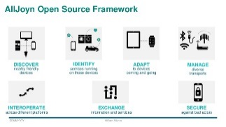
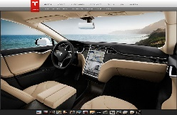
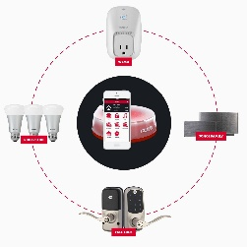
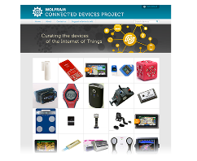
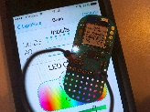
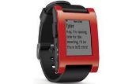
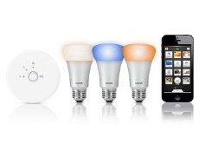
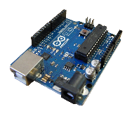

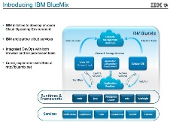


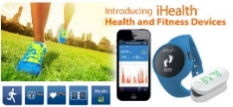
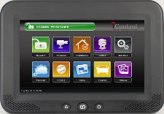

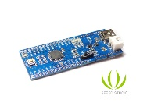
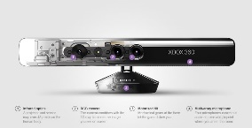
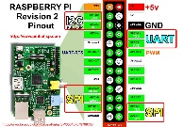
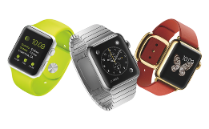
The Internet of Things (IoT) Today
Ideas in search of a problem?
Notes:
Much of the IoT references publicly consumer based, often obscure ideas
What is the Enterprise play
Enterprise mentions at Citrix- often referred to Teslas
Example of Overhype

Slide 36
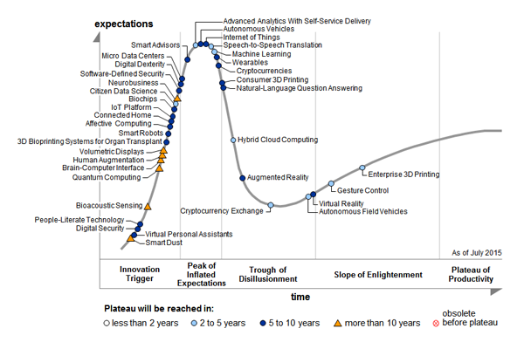
IoT: On the Cusp of the Trough of Disillusionment?
Ready for the plunge?
Gartner Hype Cycle July 2015
Notes:
Getting ready to enter trough of disillusionment, overhyped?

Slide 37
Internet of Things in Higher Education
Research from Forrester shows less interest in IoT in higher education than most other industries
Is there an IoT opportunity in Higher Education?
IoT Adoption Plans
Interest in using IoT to Optimize Resources & Enhance Operational Processes
Source: Business Technographics Global Mobility Survey, 2015, Forrester Research, Inc.
Notes:
However, those investing in IoT are more likely to invest in facility management (55%) compared to other industries (38%)

Slide 38
Trends in Education: What we are Hearing
“A big way to focus on student success factors is to let technology get out of the way”
Community College in North Carolina
“We want to leverage technology to offer a highly personalized education experience”
Public University in Arizona
“In 5 year’s time we want student to move fluidly between physical and virtual campuses”
Public University in Australia
“We want a magic wand for our faculty- they just want to teach, they don’t want to be trained”
Private University in Florida
Notes:
Add in more detail of the story, perhaps here

Slide 39

Is There an IoT Opportunity in Higher Education?
Trend & Challenge: Higher education is looking to reach more students
The question we should be asking:
“Is there an opportunity to help Higher Ed serve more students successfully?”
Then ask ourselves: How can IoT enable this?
Notes:
IoT can enable this by getting technology out of the way of teaching and learning

Slide 40
Initial Assumptions
What we wanted to test in our initial interviews
Universities/Colleges are interested in serving a larger number of students (and often struggling in the process)
Our Assumptions:
Online and Hybrid classes is one mechanism to serve more students
Online and Hybrid classes need to be as interactive as possible
Adding new tech to support online/hybrid classes is of interest, but only if:
It is inexpensive
Does not introduce complexity for the instructor and the student
It is consistently applied to everyone on campus
Supports the broadest range of devices possible

Slide 41
Initial Interviews
Get to know who we are talking to
Interview Script: User Profiling
Can you tell me a little about what you are responsible for?
What does a typical work day look like?
What are your top priorities right now?
For each priority/ job ask:
What is the goal
What are the biggest challenges you have had
Can you tell me a little bit about the last time you had this problem?
Started with the same profiling questions used with the last case study
41
Notes:
Here’s the empathy part of the interview.
One thing that’s really important – Renee called this out last time: Notice you ask about the person and their goals & challenges, not their needs.
What happens if you ask someone what they need?
If this is an empathy interview, you stop here. You don’t have any assumptions to test yet. The interviews you’ll do in the next couple of weeks will likely have this character.

Slide 42
Initial Interviews- Test #1
The first test was to learn more about their classroom environment
What does your classroom environment look like?
Typical classroom?
How has it changed in the last 2-3 years?
Plans for the future?
Instructor frustrations?
What does the online classroom look like to you?
Synchronous vs asynchronous?
Flipped classrooms?
Making decisions around classroom changes:
How to measure instructor and student feedback?
Then asked specific questions about their classroom environment
Focusing on what’s changed, what’s coming, what challenges they face
Notes:
Here’s the empathy part of the interview.
One thing that’s really important – Renee called this out last time: Notice you ask about the person and their goals & challenges, not their needs.
What happens if you ask someone what they need?
If this is an empathy interview, you stop here. You don’t have any assumptions to test yet. The interviews you’ll do in the next couple of weeks will likely have this character.

Slide 43
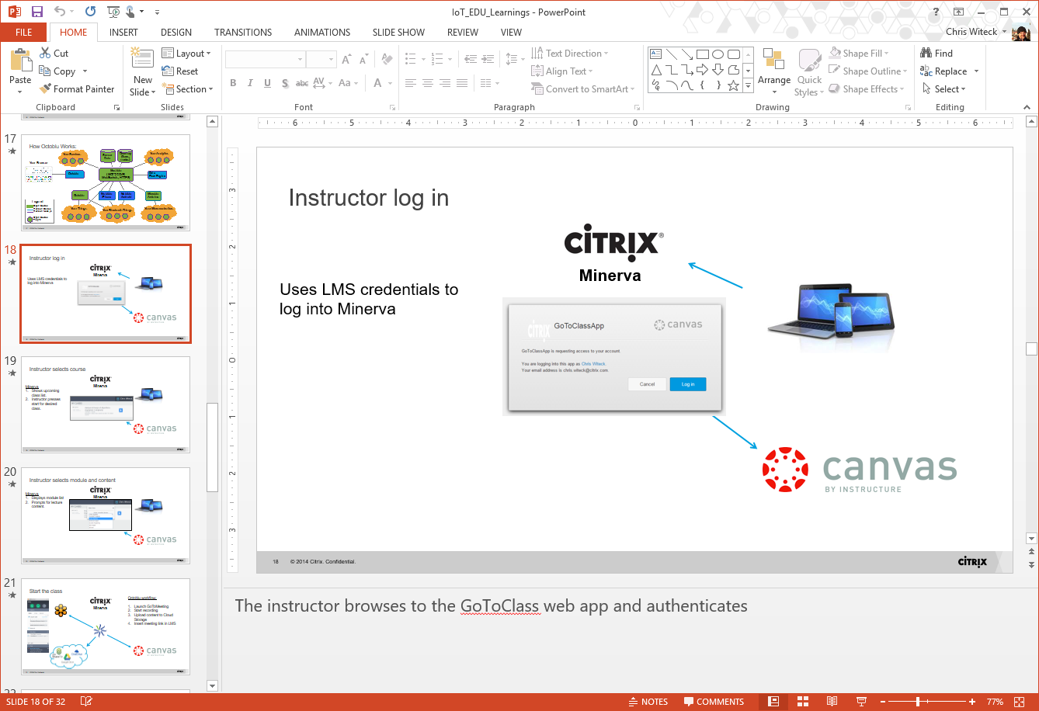
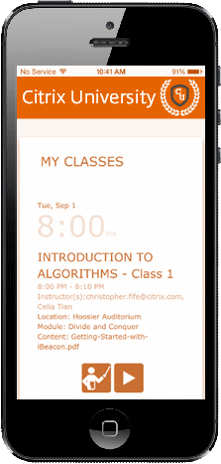
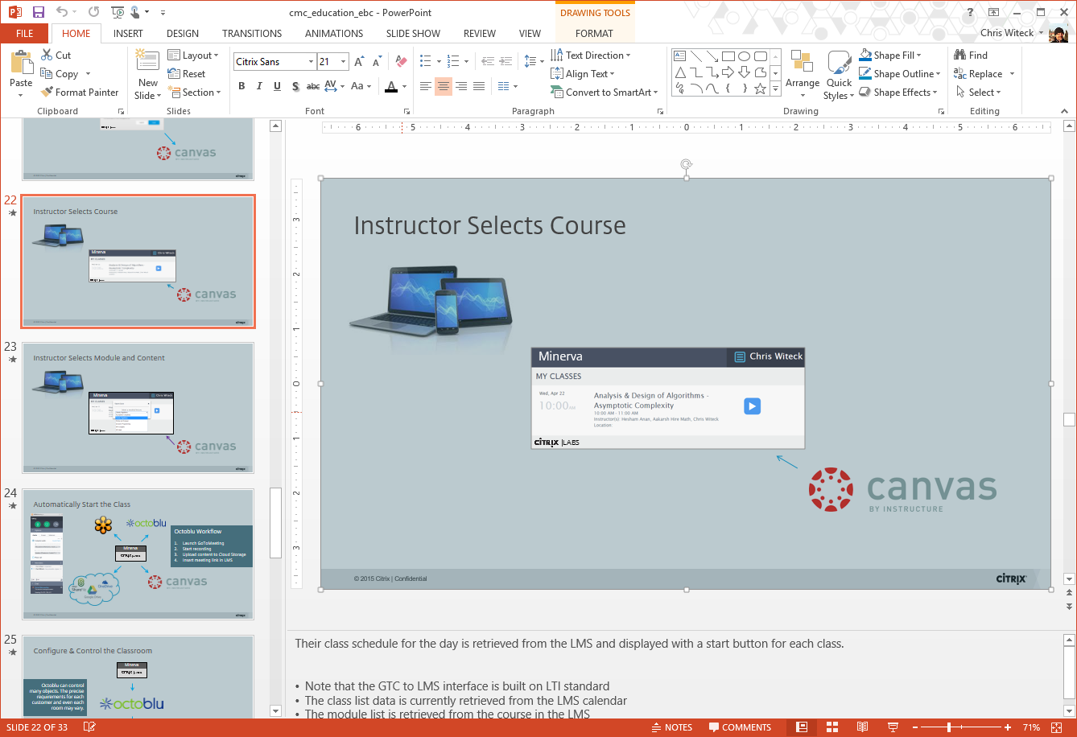
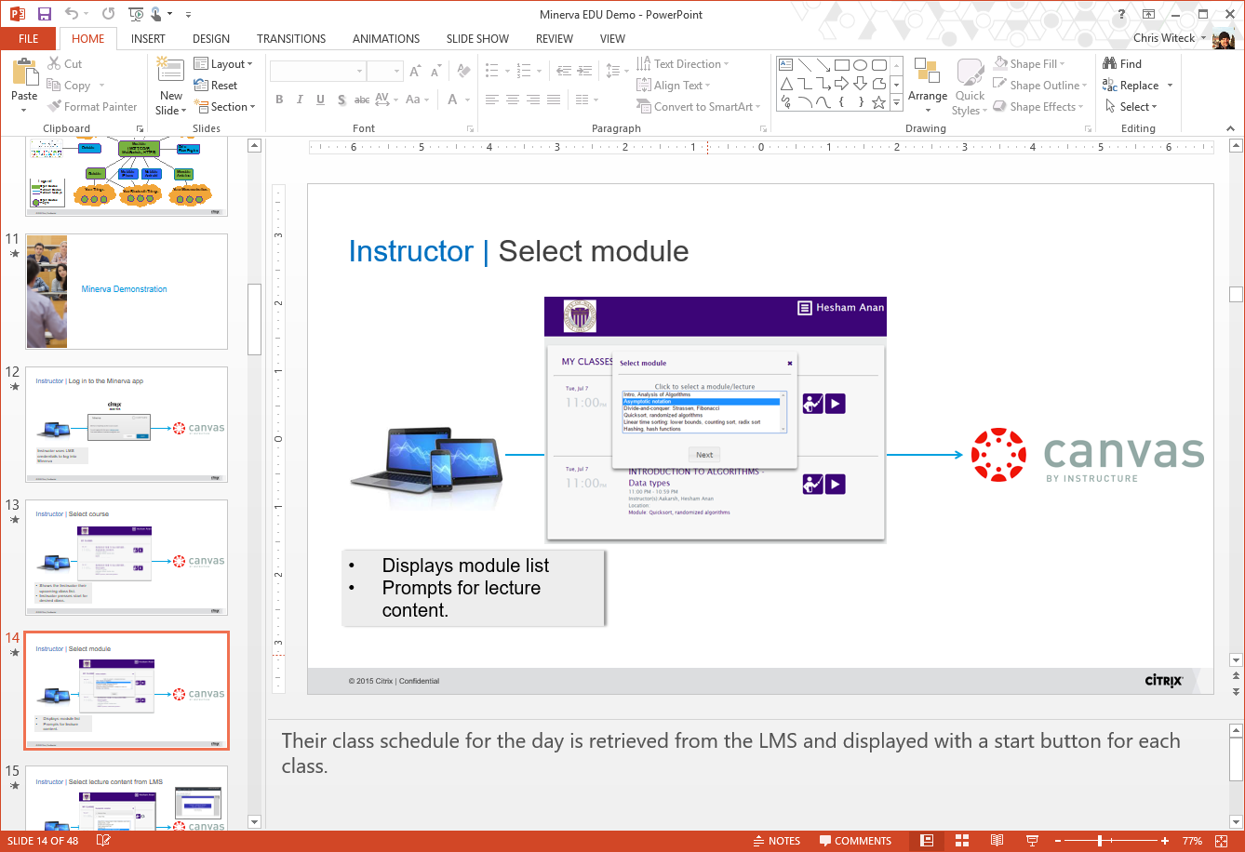
Initial Interviews- Test #2+
Continually tested, reviewed learnings with every phase of the prototype development
We gradually increased the fidelity over time, continually testing
Notes:
Here’s the empathy part of the interview.
One thing that’s really important – Renee called this out last time: Notice you ask about the person and their goals & challenges, not their needs.
What happens if you ask someone what they need?
If this is an empathy interview, you stop here. You don’t have any assumptions to test yet. The interviews you’ll do in the next couple of weeks will likely have this character.

Slide 44
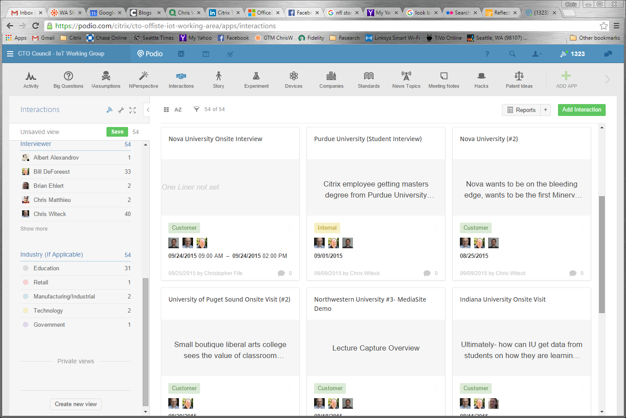
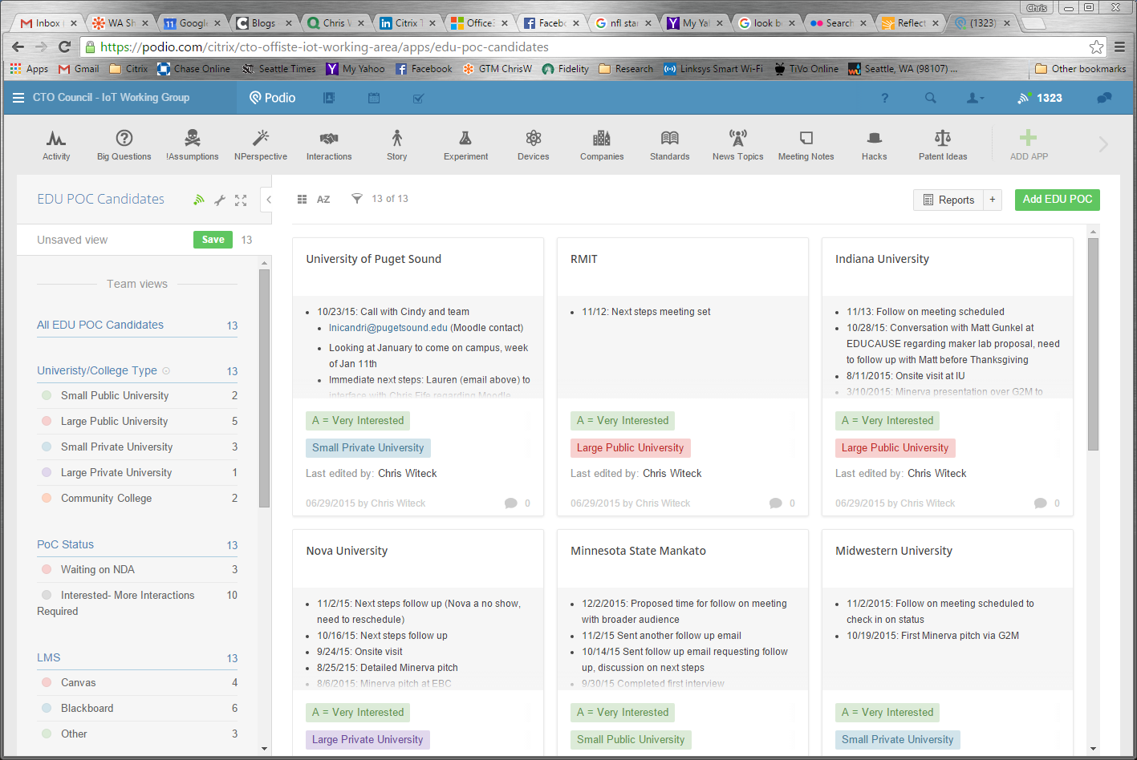
Capture and Shared Evidence
Interview synthesis:
Organized by willingness to allow us on campus to test our prototype

Slide 45
Lessons Learned
Encouraged by progress to date
Positives:
Established an emotional connection to a need
Ongoing empathy mapping
Broad involvement with empathy mapping
Included PMs, architects, program management
Participation in daily standups to report progress, take questions
Negatives:
Still early, have not fully assessed viability and feasibility
Still need to pull in other stakeholders to further test desirability
Summary:
Improved incorporating empathy mapping with all aspects of the project
Unknown- scaling this to a large development team
Notes:
Broad technical involvement with empathy mapping
Interview team includes architects, program management
Interview team participates in daily standups to report progress, take questions
Able to incorporate new prototype elements to test after each sprint

Slide 46

Summary
Develop empathy throughout your entire project
Start broad, then gradually narrow your focus
Identify your stakeholders
Focus on your key stakeholders (but don’t ignore other stakeholders)
Translate learnings to evidence, needs statements
Share your evidence, involve the entire team
Notes:
Well that was a fun video. Spaces will sense us, know who we are, now about our meetings and automate things for us to save us time.
Work is undergoing a tremendous transformation. But what forces are causing this change.

Slide 47
Chris Witeck
Principal Technology Strategist- Citrix Labs
chris.witeck@citrix.com @cwiteck

Slide 48
Lessons Learned
Encouraged by progress to date
Positives:
Established an emotional connection to a need
Broad technical involvement with empathy mapping
Interview team includes architects, program management
Interview team participates in daily standups to report progress, take questions
Able to incorporate new prototype elements to test after each sprint
Negatives:
Still early, have not fully assessed viability and feasibility
Still need to pull in other stakeholders to further test desirability
Summary:
Improved incorporating empathy mapping with all aspects of the project
Unknown- scaling this to a large development team
Notes:
Here’s the empathy part of the interview.
One thing that’s really important – Renee called this out last time: Notice you ask about the person and their goals & challenges, not their needs.
What happens if you ask someone what they need?
If this is an empathy interview, you stop here. You don’t have any assumptions to test yet. The interviews you’ll do in the next couple of weeks will likely have this character.

